Slide 1
Automated Stock Trading
Vantage AI
29
July
2025

Slide 2
Contents
01
Objective
Slide 03
02
My Background
Slide 04
03
Methodology
Slide 05
04
Results & Deliverables
Slide 11
05
Insights
Slide 17
06
Learnings & Next Steps
Slide 18
Matthew Sathiaraj

Slide 3
Create a stock trading bot that trades on the U.S. stocks automatically based on news sentiments.
Objective
Matthew Sathiaraj

Slide 4
My Background
Programming Languages that I know:
Python
HTML/CSS
Java (a little bit)
I’ve taken classes/courses on Python and HTML/CSS and have worked on assignments (and projects) that use these languages.
Matthew Sathiaraj

Slide 5
Methodology - Sectors
Automated stock trading is split into 4 sectors:
Technology/Communication
Health Care
Financial
Industrial - Airlines
Splitting trading into sectors makes the trading strategy work consistently over all stocks in each sector.
Matthew Sathiaraj

Slide 6
Methodology - Stock Tickers
Technology
Health Care
Financial
Airline
NVDA MSFT AAPL AMZN GOOGL META AVGO TSM TSLA ORCL ADBE CSCO INTU QCOM
UNH JNJ PFE LLY ABT ISRG TMO TDOC
JPM BAC WFC C GS
AAL DAL UAL ALK SAVE SKYW HA
Matthew Sathiaraj

Slide 7
Methodology - Overall Strategy
Auto-trade executed
For each ticker…
Step 1
Step 2
Step 3
Pull stock news from Finnhub (published during specific timeframes) and score it using Vader.
Check if score is greater than a base value and less than limit value for stock sector.
If requirement is met, execute bracket order with loss-prevention and gain limitations.
Matthew Sathiaraj

Slide 8
Methodology - Steps to Design Strategy
How are the base, limit, loss-prevention, and gain limitation values chosen? How are the timeframe values set?
Base code: main auto_trade script without values.
Step 1
Step 2
Step 3
Step 4
Step 5
Start with backtest_outline.py. Backtest with randomly chosen values.
Test by changing values based on backtesting performance.
Come up with the best possible strategy (combination of values that gives the best profit).
Implement values in base code for automated trading. Add ticker csv to pd.read_csv.
Repeat steps to develop new strategy for other sectors.
Matthew Sathiaraj

Slide 9
Methodology - Strategy Values
Base: minimum news score for ticker to be traded.
Limit: maximum news score for ticker to be traded.
Backtesting Values…
Added Limit: limits how high the stock’s price goes before making a sell/liquidate.
Prevent Loss: limits how low the stock’s price goes before making a sell/liquidate.
Initial Balance: starting balance to test gain/loss in backtesting.
Base Data & Timestamp 13, 20, Fallback 13: trading day to backtest on as well as published after and published before times for news pulling from Finnhub.
Matthew Sathiaraj

Slide 10
Methodology - Versions Used For Auto-trading
Version 1
Version 2 - Best & Current
News score had no limit for how high score could be.
No scheduling in script.
Market order only.
Checked news scores at intervals to execute sells.
Traded on stocks of many sectors.
Problems:
There were too many days with loss due to one general limit value.
Github Actions scheduling needed to be perfect.
Sell order strategy was not great because I could not sell based on my risk level.
With tickers split into multiple sectors, values can be unique per sector. These values include published after and before news times.
Scheduling in script.
Bracket-orders that allow for price limiting and loss-prevention.
One-time liquidation (at end of trading day) of all remaining stocks.
Fixed Problems From V1:
Reduced loss and improved consistency due to splitting by sector.
Scheduling does not have to be perfect.
Sell order strategy highly improved to maximize gains.
Matthew Sathiaraj

Slide 11
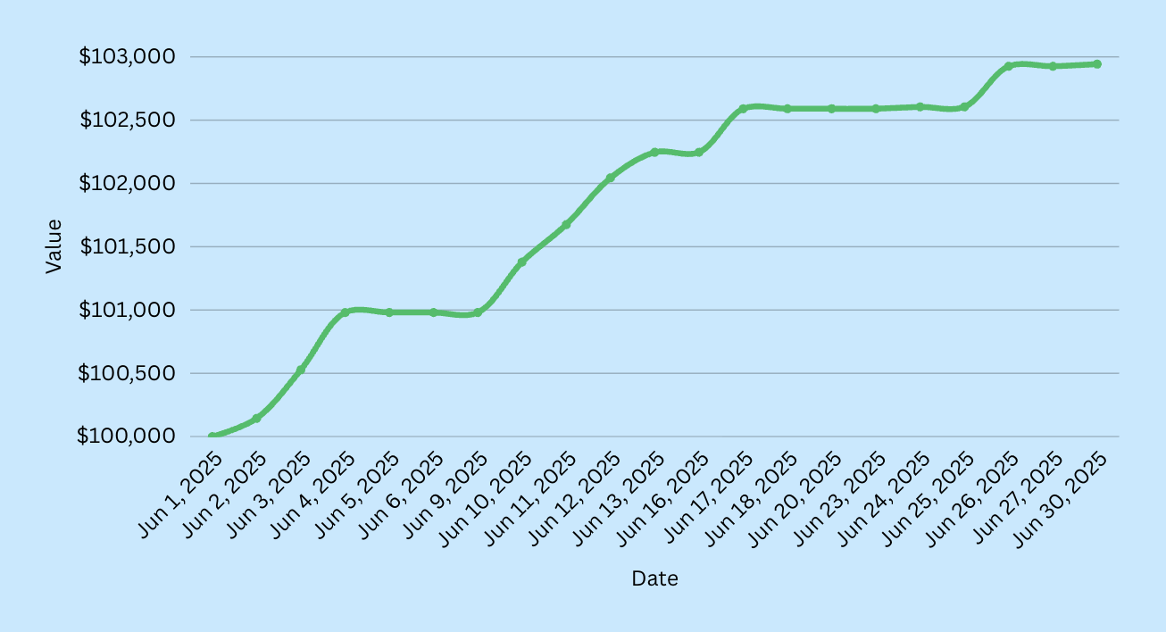
Results & Deliverables - Technology Sector
Backtesting Dates:
Jun 1 - Jun 30
Total Profit: $2,942.88
Profit/Loss Technology Stocks
Interactive Graph
Matthew Sathiaraj

Slide 12
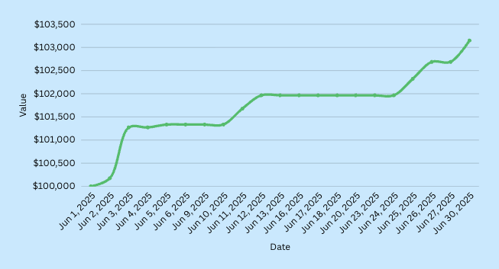
Results & Deliverables - Health Care Sector
Backtesting Dates:
Jun 1 - Jun 30
Total Profit: $3,149.92
Profit/Loss Health Care Stocks
Interactive Graph
Matthew Sathiaraj

Slide 13
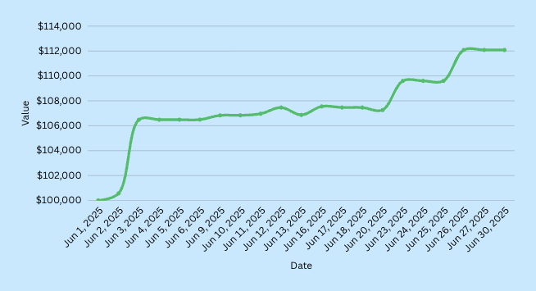
Results & Deliverables - Financial Sector
Backtesting Dates:
Jun 1 - Jun 30
Total Profit: $12,084.66
Profit/Loss Financial Stocks
Interactive Graph
Matthew Sathiaraj

Slide 14
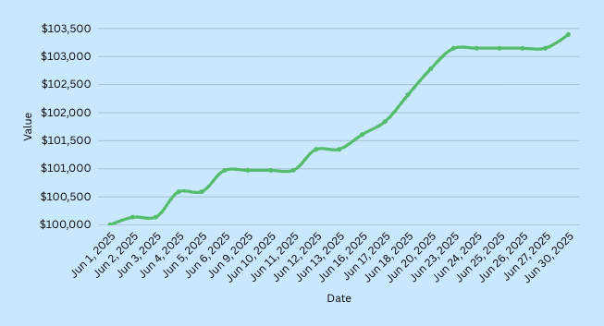
Results & Deliverables - Airline Sector
Backtesting Dates:
Jun 1 - Jun 30
Total Profit: $3,392.66
Profit/Loss Airline Stocks
Interactive Graph
Matthew Sathiaraj

Slide 15
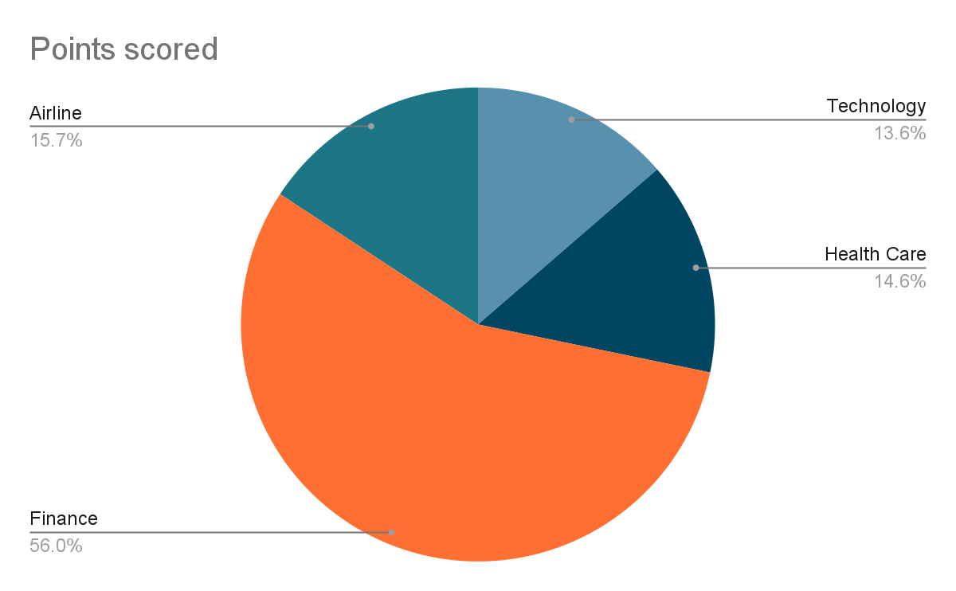
Results & Deliverables - Profits
Risk Level:
Technology - Low
Health Care - Medium
Financial Stocks - High
Airline Stocks - Low
Financial Stocks did well with the
high amount of trading risk.
Matthew Sathiaraj

Slide 16
Results & Deliverables - Main Deliverables
Deliverables
Actions
Working Python script for real-time trading
AI-based news analysis and trading execution
Performance and strategy report
For every sector, there is automated trading script for real-time trading as well as backtesting script to improve trading script.
The trading and backtesting script uses VADER (which is AI based) to score news. Trading execution happens automatically based on the news score provided by VADER’s Sentiment Intensity Analyzer.
In the shared Google Drive, there is a document with performance information, and another document with strategy.
Matthew Sathiaraj

Slide 17
Insights
API: Finnhub is a great news API to use. They provide 60 API calls per minute as well as news catered towards stocks. Alpaca API is a good way to test out paper trading through code.
Libraries/Tools: VADER is quick and easy to use. With the right amount of news, it can effectively score to provide insight on when to trade or not trade. Pandas works really well with storing stock data in csv files and reading data from Data Frames.
Backtesting: Backtesting proved to be a great and efficient way to test strategy and performance. Backtesting allowed me to create strategies that made high amounts of profit in the backtesting timeframe.
Matthew Sathiaraj

Slide 18
Next steps
Step 1
Paper trade everyday for the next month using strategy developed. Record performance and change strategy accordingly. Add more risk if strategy is working well.
Step 2
Convert code to work with live trading account (either Alpaca or another broker). Test with actual money.
Step 3
If live trading works well, develop a UI interface to monitor performance and schedule trading.
Matthew Sathiaraj

Slide 19
Thank you!
Contact me
matthewjs1117@gmail.com
Matthew Sathiaraj

